Slide 1

Analyzing The Air Traffic Trend Based On Passenger And Landing Count In United States
Database & Analytics Programming(MSCDAD_JAN23A_I)
Chandana Haluvarthi Prabhudeva(x22167099)
Pratheek Gogate(x22159789)

Slide 2
ABSTRACT This study seeks a better understanding of the increase in air travel and the number of aircraft landings in relation to the operating airline, passenger count, and landing count, among other fields, for the years 2005 and after. ETL, modelling and visualization techniques are used to check the growing airline industry; the two datasets are driven from the United States traveler's details taken from the US government as an open source.

Slide 3
DATASET1 Air traffic Passenger Statistics data from 2005 to 2022 (from US data gov website) Dataset is about Monthly Passenger Statistics by Airlines at San Francisco International Airport Transformations used - Dealing with null values , duplicates and changing the data types in a such a way that its ready for plotting. Data loading - Source → Mongo DB (ETL) → Postgres server Visualization: Bar plot (Total Passengers by Operating Airline, People's Travel count on Yearly basis, Proportion of Passenger Counts by Region and Activity Type), Group Bar Chart(Passenger count based on Geo region) Pie chart (Passenger Distribution based on activity type, distribution of activity types), Scatter plot(Scatter Plot of Geo Summary and Price Category Code)

Slide 4
DATASET2 Air traffic Passenger Statistics data from 2005 to 2022 (from US data gov website) Dataset is about Monthly Flight Landing Statistics by Airlines at San Francisco International Airport Transformations used - Dealing with null values , duplicates and changing the data types in a such a way that its ready for plotting. Data loading - Source → Mongo DB (ETL) → Postgres server Visualization: Bar plot (Top 10 Operating Airlines by with Highest Number of Landing, Total number of landings by aircraft manufacturer, Total number of landings by Geo Region),Pie chart (Percentage of landings by aircraft body type, Distribution of landings by geo summary), Line graph(Trend of total landed weight over time)

Slide 5
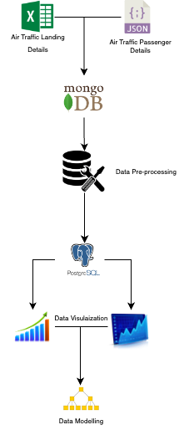
Project Flow
Step 1 : Reading the source data
Step 2: Loading Individual datasets to Mongo DB
Step 3 : Extract, Load, Transform
Step 4: Load the data to PostgreSQL
Step 5: Data Visualization
Step 6:Combine the datasets and loading it into PostgreSQL
Step 7:Visualisation
Step8: Model Building

Slide 6
Combined Dataset We combined both the datasets using common columns and then loaded into Postgres. Visualization: Bar plot (T Passenger count by Operating Airline and Aircraft Body Type (Top 10 Airlines), Passenger Count based on Aircraft Manufacturer and Operating Airline),Boxplot(Landing count by Terminal), Scatter Plot(Relationship between Total Landed Weight and Total Passenger Count). Model Building: The passenger count and landing count predictions are calculated in this analysis, the landing count is predicted with an accuracy of 94%, and we have got to know that the passenger count data is not suitable for this type of prediction and requires more data to do so.

Slide 7
Conclusion The analysis of this project shows that the passenger count has increased over the years but has decreased during the pandemic. Still, the passenger count is highly dependent on the airlines and their manufacturer. The landing count has also increased over the years in the major regions and depended on aircraft type and model; the visualizations helped back this result. The study also helps to predict the landing count using Decision Tree with an accuracy of 94 percent, which can be used for airline improvement and airport management.

